Slide 1

Work Programme 2023 – 2024
Dr. Patrick Antoine
CEO & Technical Director
3rd Annual General Meeting
11 July 2023

Slide 2


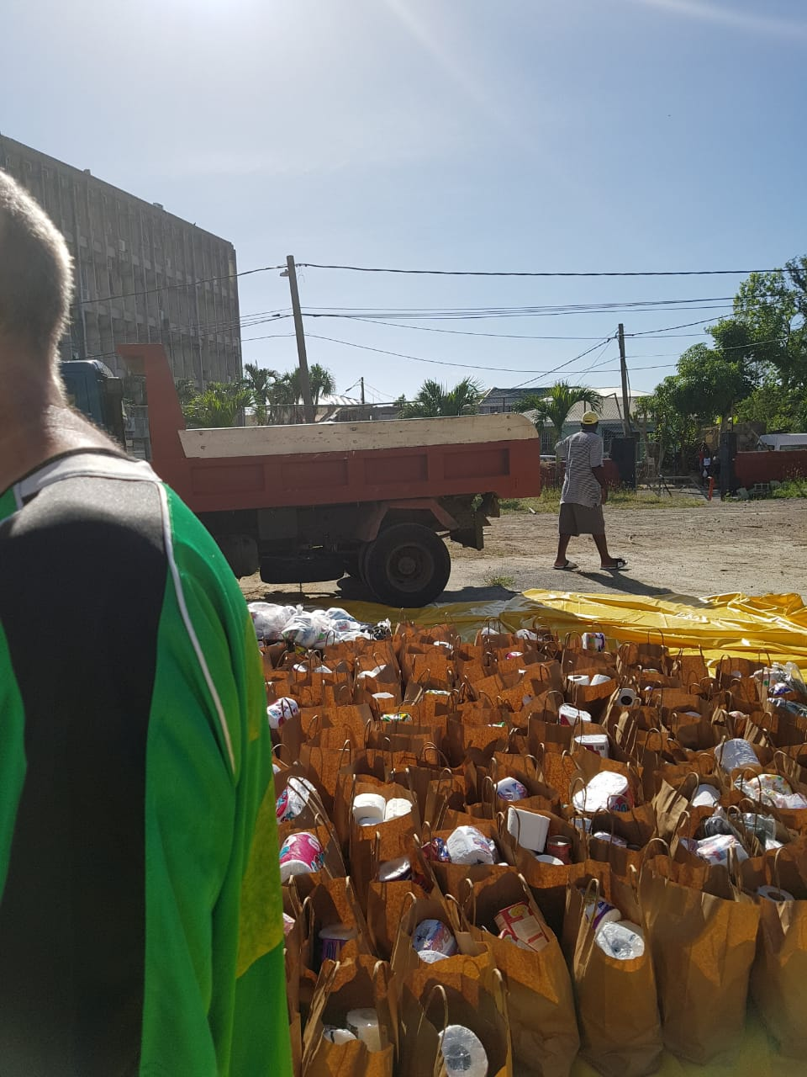

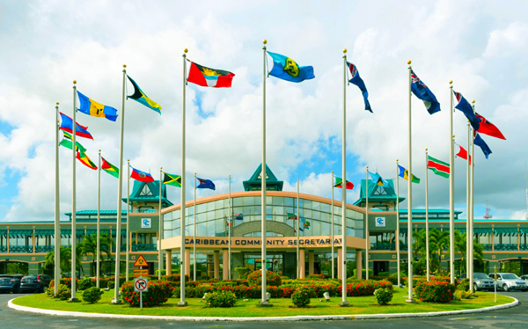



Private sector investment in resilience, financial instruments for climate and disaster-related fiscal risk management , climate change
Facilitate Trade in Goods
Non- Tariff Barriers; CET and ROO Reform; Trade Facilitation; Statistical System; Front of Package Labelling ;Industrial Products, Special Economic Zones
Disaster Risk
Reduction and Recovery
Free Movement of Labour
Free Movement of approved Categories;
Expansion of approved categories; Transparent Procedures; Movement of Factors; Contingent Rights
CPSO STRATEGIC PRIORITIES
SPS, Food Safety and Quality and Standards;
Food and Nutrition Security; Intra-Regional Agri-food Trade - 25% x 2025; Increase business in Extra-Regional Markets
Expanding Agri-food Value-Chains
Regional Company Registry; Financial Services Regulation; Transportation (Maritime); Access to Credit for MSMEs; Trademarks and IP; Digital Transformation; Registration of property; Insolvency Framework; Mergers and Acquisition Policy;
Enabling Business Environment
Finance and Capital Markets Deepening/Integration
Integrated Stock Mkt – Single Regional Stock Exchange; Democratizing Wealth Creation;

Slide 3

WORK STREAMS
1 – Work which the Community has embarked upon as part of the CSME Agenda.
2 – Priority areas and subjects initiated by the regional private sector; work requiring specific treatment- articulation by private sector interests
3 – Responds to specific approaches by the CPSO Membership, COTED, and Member States on priority matters germane to the expansion of intra-regional trade.

Slide 4


STRATEGIC PRIORITY 1

Slide 5
  Review of the CET and RoO:
Convene regular meetings of the Private Sector Working Group on CET and RoO to ensure strong private sector alignment.
Participation in the Sectoral Working Groups in relation to the Review of the CET and RoO. The deadline for completion of the Review Process is now July 2024.
Non-Tariff Barriers:
Work with the CARICOM Secretariat to establish the appropriate modality for notification of NTBs and Non-Tariff Measures (NTMs) to Trade in CARICOM.
Encourage and support the private sector to submit complaints on NTBs to the CPSO.
Use analysis and advocacy to encourage Member States to eliminate NTBs.

Slide 6
INDUSTRIAL POLICY AND INDUSTRIAL PRODUCTS
Collaborate with the CARICOM Secretariat and Member States to complete the Industrial Policy Framework for CARICOM.
Advance policy coherence with the work on Special Economic Zones and emerging technologies as part of the Industrial Policy framework.
Complete analytical work and CET alteration proposals, for the three industrial products identified, for submission to the November 2023 COTED.
On behalf of regional private sector advance work aimed at securing and developing regional opportunities for industrial products (7 additional products as requested by CHOGs).
Participate in the Open-Ended Working Group to advance the Fast-Track proposal for CET alterations.

Slide 7
SPECIAL ECONOMIC ZONES
Collaborate with Member States and other stakeholders towards the development of Draft Model legal framework for SEZs.
Pursue recognition of the pertinent changes to the trade regime that supports production integration including via SEZs.

Slide 8

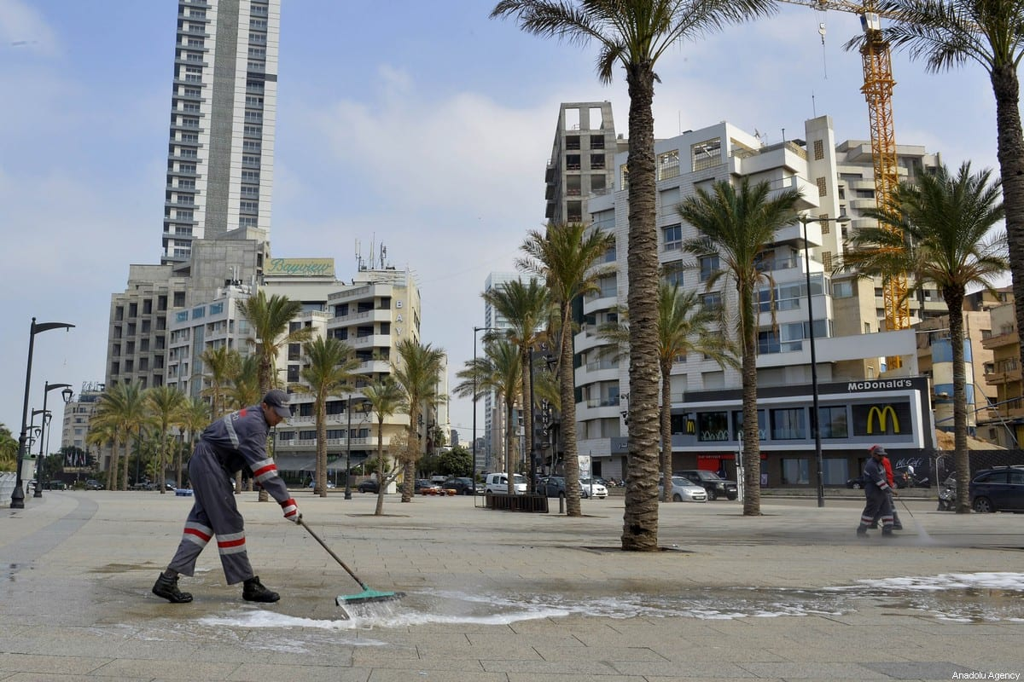

STRATEGIC PRIORITY 2
This Photo by Unknown Author is licensed under CC BY-SA-NC

Slide 9
MOVEMENT OF COMMUNITY NATIONALS
Free Movement of ALL CARICOM Nationals by March 2024 approved at recent 45th CHOGs July 3rd -5th 2023
Support implementation
Advance the best strategic approach for free movement by the Community (Member State by Member State)
Encourage domestic legislative changes that are required to give effect to the free movement by CARICOM nationals based on the strategic option(s) selected by Member States.
Advocacy and engagement with the Member States to provide for the rights contingent to free movement.

Slide 10


STRATEGIC PRIORITY 3

Slide 11
25% X 2025 INITIATIVE
Coordinate the private sector participation towards pursuit of the 19 potential strategic investment opportunities in production, infrastructure, processing via effective collaboration with the MTF and President Dr. Irfaan Ali
Identify and mobilise resources for preparation of Business Cases among Member States including the OECS.
Identify and invite entrepreneurs and agri-businesses to take up incentives and opportunities from CARICOM Governments Programmes
Collaborate CRFM in developing investment business cases for the fisheries sector.
Collaborate with CARICOM Secretariat, CAHFSA and other development partners in eliminating existing SPS barriers for the Agri-food opportunities for which the private sector has raised strong concerns.
Preparation of financing projects to support MSMEs in critical ‘bottleneck’’ areas, particularly, those with ‘proof of concept’.
Development of “partnership Model’ to support MOA with the Consortium of Universities involved in Agricultural Education and Research.
Coordinate private sector participation in significant regional agri-food trade and investment events
Engage Development Partners for funding support for the Cassava Business Case as a pilot opportunity.

Slide 12


STRATEGIC PRIORITY 4

Slide 13
Harmonisation of Company Laws
Provide the CARICOM Project Steering Committee (PSC) with technical guidance and recommendations based on perspectives drawn from ongoing consultations with the legal practitioner Working Group on the CARICOM Companies’ Registry and the general framework of harmonised corporate legislation.
Development of Rules of Procedure for the Enforcement of Rules of Competition
Continue engagement with the CARICOM Single Market and Trade (CSMT) Directorate and the CARICOM Competition Commission (CCC) on a ‘best-practice’ structure for a regional competition law and policy framework.
Facilitate engagement with the CCC and the private sector towards determination of an appropriate CCC model.

Slide 14
Regional Trademark Administration System
Collaborate with private sector in preparation of a technical capacity building project to support regional firms, particularly MSMEs, to identify and optimize their intellectual property rights.
Contribute to work in the area of ‘Trademarks’ within the Community Work Programme.
Regional Public Procurement
Ensure that private sector concerns are sufficiently addressed, and recommendations are incorporated into the governing documents for the CARICOM Procurement regime.
ICT and Digital Transformation
Establish an ICT and Digitalization Working Group(s) to advance proposals to enable regional ICT and Digital transformation.
Collaborate with regional Business Support Organizations to host various awareness building and knowledge sessions on issues such as Artificial Intelligence, fintech and its possible impact and opportunities.
Collaborate with the CARICOM Secretariat on implementation of the Action Plan for ‘Fast Tracking’ Digital Transformation in CARICOM.
Support the concept of ‘fairshare’ among ICT providers, content suppliers, platform users

Slide 15


STRATEGIC PRIORITY 5

Slide 16
CAPITAL MARKET INTEGRATION AND SINGLE REGIONAL STOCK EXCHANGE
Collaborate with CARICOM Secretariat and Member States to advance work on the legal, regulatory, and institutional frameworks required to support a single regional space for the operation of capital and finance firms.
Collaborate with key private sector stakeholders, Ministries of Finance and Central Banks, in exploring the establishment of a Single Regional Stock Exchange.

Slide 17
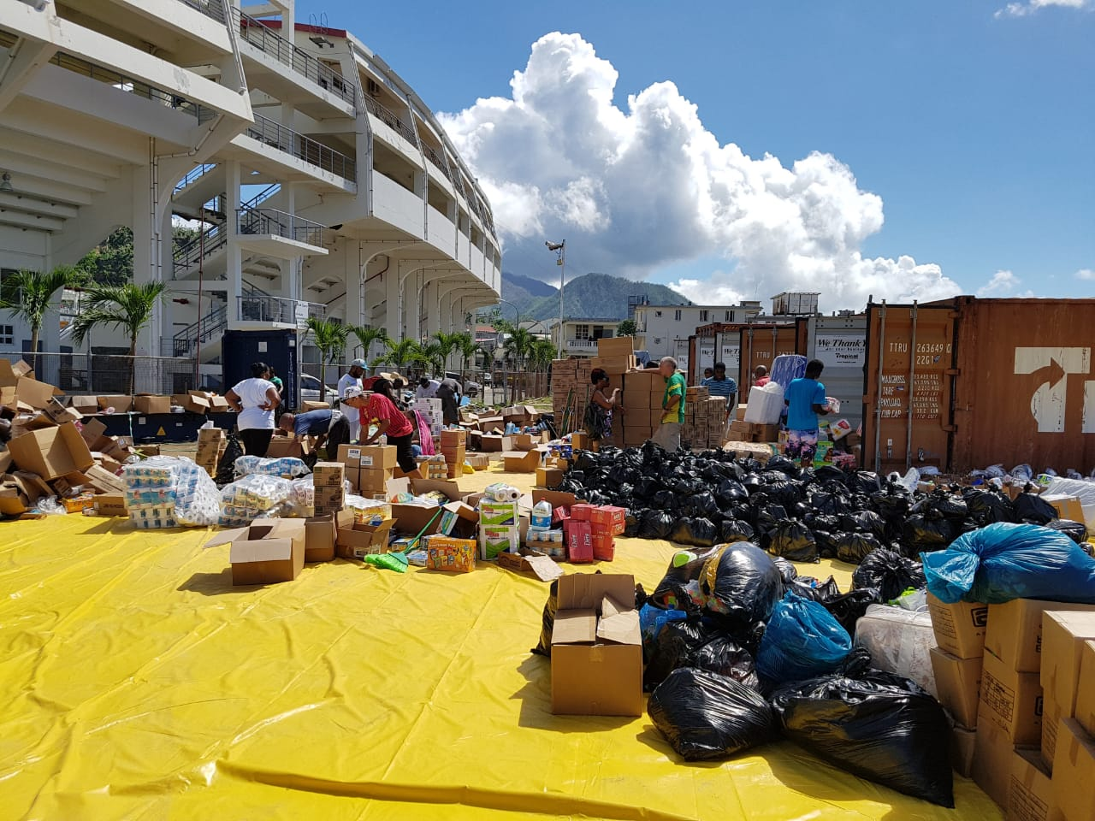
STRATEGIC PRIORITY 6
Disaster Risk
Reduction and Recovery

Slide 18
DISASTER PREPAREDNESS AND RESPONSE
Collaborate with Development Partners and Member States to mobilize resources to support the creation of private sector climate investment plans and finance-ready projects.
Support development of products to strengthen climate risk financing for private sector firms especially MSMEs operating in vulnerable sectors.
Continue engagement with CDEMA and participation in the Caribbean Development Partners Group (CDPG)

Slide 19
OTHER STRATEGIC AREAS OF WORK

Slide 20
ADDRESSING THE CHALLENGE OF NCDS
Intensify the activities of the private sector Working Group towards the development of a comprehensive package of measures that address diets, education and awareness, and exercise.
Continue engagement with Stakeholders towards a balanced outcome on FOPNL
Support, advance, and implement ‘Calorie Content Initiatives’ being developed in collaboration with CANDi.
Complete a compendium of ongoing, planned, and future initiatives by regional private sector entities which contribute directly and indirectly to the NCD Agenda in CARICOM to highlight best practices that can be shared across the Region.

Slide 21
NEARSHORING
CPSO requested by the Fifty-Sixth Meeting COTED to lead in preparing a technical paper on the Nearshoring opportunities with the United States.
Paper will inform CARICOM’s position at the upcoming United States-CARICOM Trade and Investment Council (TIC), September 2023.
Establish a Technical Group to conduct the work and preparation of the Nearshoring Paper for September 2023.

Slide 22

INSTITUTIONAL BUILDING

Slide 23
AWARENESS AND OUTREACH
Strengthen competence in Public Relations Capacity.
Develop and implement an engagement strategy to sensitize key stakeholders on the role of the CPSO.
Develop and implement a media/public engagement plan to inform on key CPSO initiatives and to build its profile in the Region.
Develop a structured process for communicating with members, key policy makers and government leaders in the region/CARICOM Secretariat.
Continue work on improving CPSO’s website and key social media platforms.
Dissemination of monthly Newsletter

Slide 24
PARTNERSHIP AND COLLABORATION
Advance the CPSO – United States Business Council (USBC)
Operationalize existing MOUs - (CPSO-Caribbean Manufacturing Association (CMA) Sub-committee)
Conclude Cooperation Instruments
Pursue Partnership with other development partners

Slide 25
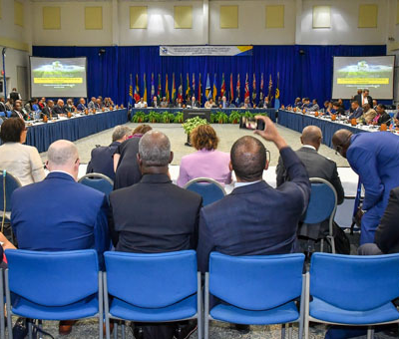


The Private Sector is engaged as never before!!!
CONTACT US
info@thecpso.org

